Slide 1
iOS Project – Briq App
92733: Leonard Mabele
92738: Jeremiah Dede Dindi

Slide 2
Project Scope
Development of an iOS App that bridges the industries and the farmers with the raw materials of manufacturing briquettes.
A briquette is a compressed block of coal dust or other biomass material such as sawdust, coffee husks and bagasse used for fuel.
In our development, farmers register through the App, fill in their location, contact, raw material they have and weight.
Briquette manufacturing industry also sign up to sign in and view this information then they can contact the farmers with the raw materials.

Slide 3
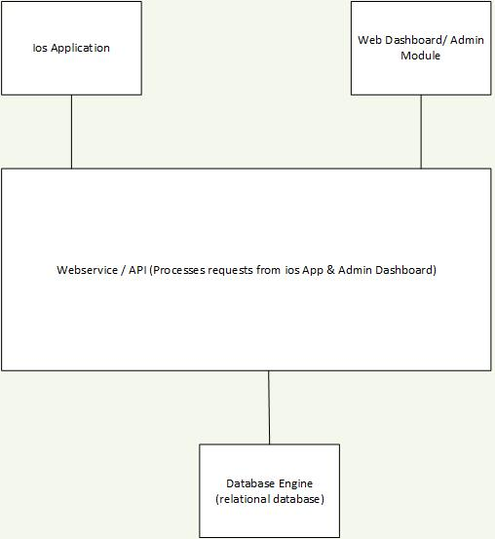
Architectural Design

Slide 4
Project Implementation
This project is to be implemented using the following tools:
Swift programming language
PostgreSQL/mysql database
Facebook framework for signup and Login.

